Slide 1
Oak Hill Elementary School Title I stakeholders’ input & Revision MEETING
March 14, 2024
7:30AM/2:30PM/6:00PM

Slide 2
Purpose of our meeting
Give all stakeholders the opportunity to provide input on
Title I Schoolwide plan
Parent and Family Engagement Policy (School and District)
School-Parent Compact
Building Staff Capacity
Reservations of Funds
Comprehensive LEA Improvement Plan (CLIP)

Slide 3
Title I school-wide plan-what is it?
The Title I SWP describes how the school will achieve the goals it has identified as a result of a comprehensive needs assessment. This is also created in conjunction with parent input.

Slide 4
2023-2024 Title I Schoolwide Plan 
2023-2024 School Goals:
Students in grades K-5 will show an increase from Fall 2023 to Spring 2024 a minimum of at least 3 points in cut scores according to Fastbridge AMath benchmark scores.
Students in grades K-5 will show an increase from Fall 2023 to Spring 2024 a minimum of at least 3 points in cut scores according to Fastbridge AReading benchmark scores.
Math Strategies:
*Moby Max will be used to help students in grades K-5 grade master state-specific, grade-level academic standards in a fun and engaging manner.
*Teachers will use a variety of math manipulatives to develop early numeracy and build computational fluency.
ELA/Reading Strategies:
Istation Reading will be used to help students in grades 1-5 master reading standards, boost comprehension, and increase lexiles.
BrainPop software will be used to help students in grades K-5 increase prior knowledge and expand vocabulary.
Science Strategies:
Interactive Notebooks will be used to support classroom instruction.

Slide 5
2023-2024 Title I Schoolwide Plan 
Social Studies Strategies:
BrainPOP software will be used to help students in grades K-5 increase prior knowledge and expand vocabulary.
Teachers will plan cross-curricular instruction aligned to Georgia State standards by incorporating concepts into reading and writing.
Parent and Family Engagement Strategies:
The Parent Resource Room will be open to parents throughout the week and parent nights.
Send home grade-specific newsletters, Parents Make a Difference, and calendars (in a format and language that parents can understand) that provide essential information to parents and foster a connection between the classroom and the home.
Professional Learning Strategies:
Faculty will participate in professional learning with the Digital Learning Coach regarding academic software resources to enhance instruction.
The Instructional Coach will assist in building teacher understanding of instructional practices as related to the Georgia Standards of Excellence and data driven instruction. The Instructional Coach will ensure high-quality instruction in classrooms through modeling, co-planning, co-teaching, book studies, and providing feedback to teachers.

Slide 6
2023-2024 Parent Engagement Program and Activities 
Parent Orientation and Curriculum Night: August 17, 2023
Parent-Teacher Conferences: September 2023
Family Math Night: September 26, 2023
Parent-Teacher Conferences: February 2024
Family Literacy Night: February 15, 2024
Title I Revision/Planning & Feedback Meeting: March 14, 2024

Slide 7
Your input on our title I SWP

Slide 8
School & district parent and family engagement policy-what is it?
Our school receives funding from Title I, part a to strengthen academic achievement.
Our school is required to develop and distribute with parents a parent and family engagement policy that establishes expectations for parent and family engagement.
Our school is also required to describe how the school will implement a number of parent and family engagement activities.
Please review the activity calendar and provide input .

Slide 9
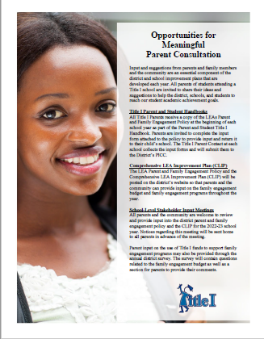
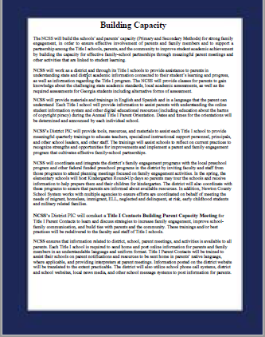
District parent and family engagement policy

Slide 10
School parent and family engagement policy

Slide 11
School parent and family engagement policy

Slide 12
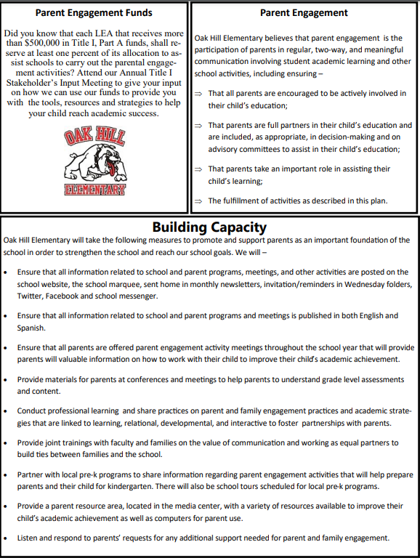
School parent and family engagement policy

Slide 13
Your input on district and school engagement policies

Slide 14
School-parent compact-what is it?
A school-parent compact is an agreement that parents, students, and teachers develop together. It explains how parents and teachers work together to ensure all students receive the support they need to reach and exceed grade level academic standards.

Slide 15
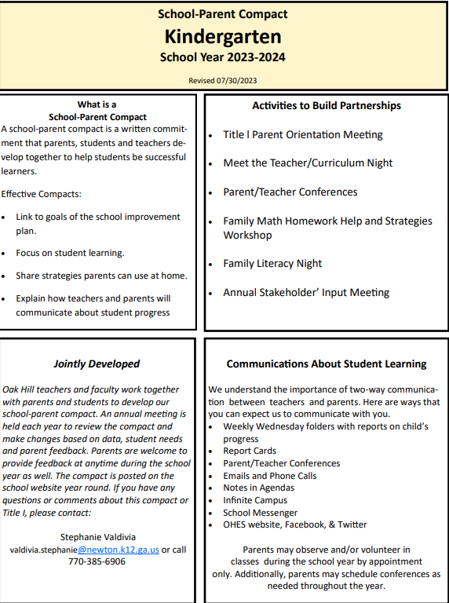
School-parent compact 2023-2024

Slide 16
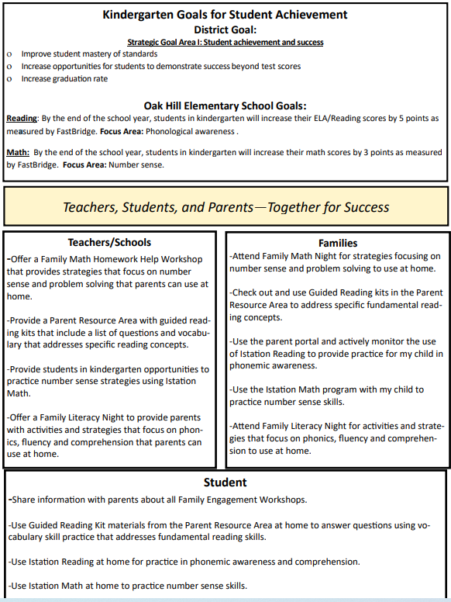
School-Parent Compacts Responsibilities and Focus Areas 2023-2024

Slide 17
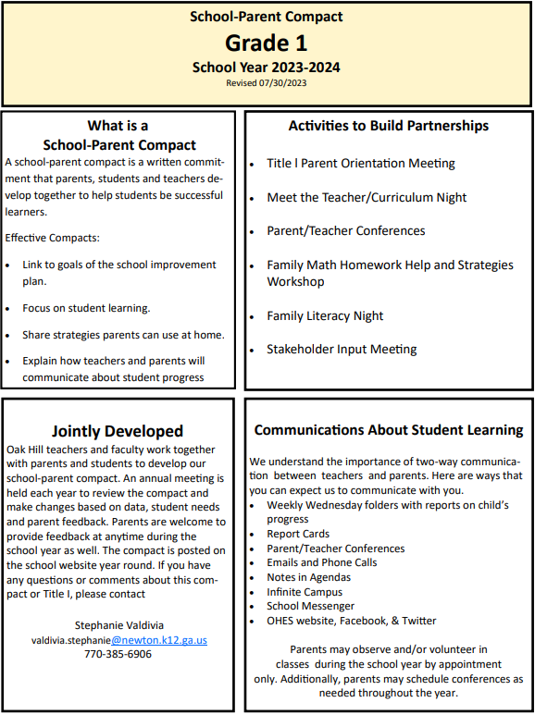
School-Parent Compacts Responsibilities and Focus Areas 2023-2024

Slide 18
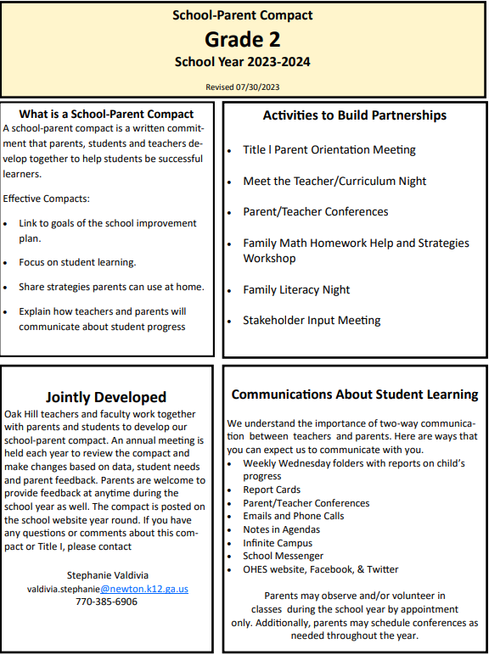
School-Parent Compacts Responsibilities and Focus Areas 2023-2024

Slide 19
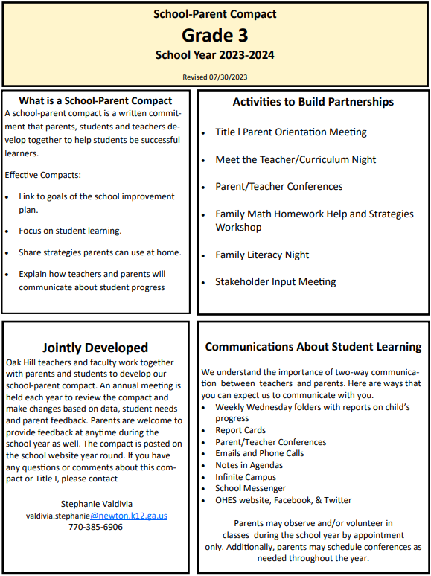
School-Parent Compacts Responsibilities and Focus Areas 2023-2024

Slide 20
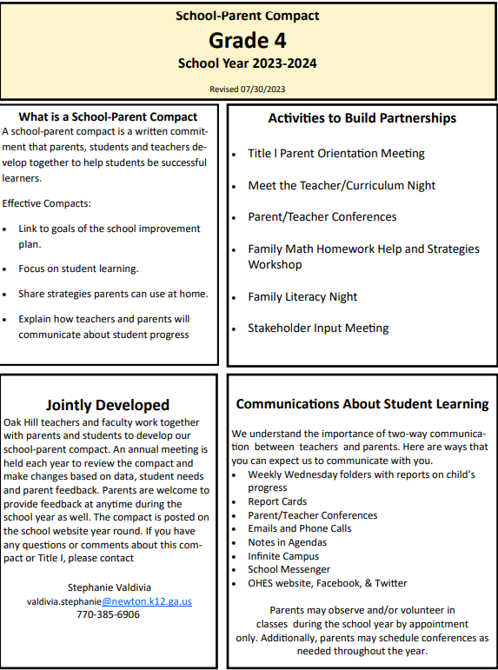
School-Parent Compacts Responsibilities and Focus Areas 2023-2024

Slide 21
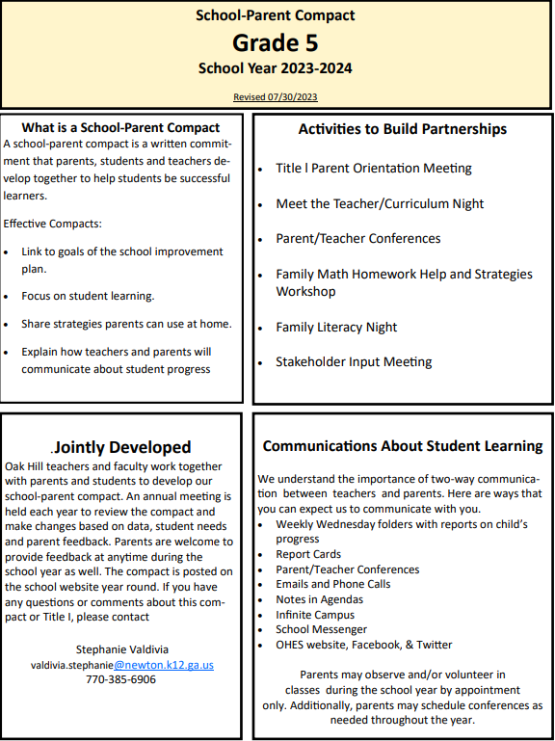
School-Parent Compacts Responsibilities and Focus Areas 2023-2024

Slide 22
Your input on our school-parent compact

Slide 23
Building Staff Capacity-What is it?
What would you like teachers to know when working with parents in the efforts to raise student achievement?

Slide 24
Your input on building staff capacity

Slide 25
Reservations of funds-what is it?
One percent (1 %) of federal funds must be spent on parent involvement at the school.
Here is how we used our Parent Involvement Funds.
Literacy Night supplies, communication folders, ink, paper
Parent Resource Room engagement packs
Interpreter

Slide 26
Your input on how we should use the 1% parent involvement funds

Slide 27
Comprehensive improvement plan (clip)-what is it?
The CLIP is a document developed by the schools and district and then approved by the Georgia Department of Education. It serves as a blueprint for guiding the school’s continuous improvement and progress towards identified school and district achievement objectives and targets.

Slide 28
2.1 Coherent Instructional System
How do you feel about the quality of instruction and support provided to students in NCSS? What are the strengths and opportunities for growth with our instructional practices?
2.2 Effective Leadership
What are the strengths and opportunities for growth in the leadership you have seen in your schools?
2.3 Professional Capacity
What should the district do to attract new educators (NCSS students) to the teaching profession? What type of support should the district provide to existing classroom teachers to enhance teaching methods, provide engaging lessons, and encourage student centered learning?
2.4 Family and Community Engagement
Do you feel the district creates a welcoming school environment and communicates effectively with parents/guardians? What are the strengths and opportunities for growth with parent and community engagement?
2.5 Supportive Learning Environment
In what ways do the school and district leaders work to provide safe and supportive learning environments through building maintenance, student emotional and behavioral support services, safety planning and extending learning opportunities? How could we improve?

Slide 29
Your input on the clip

Slide 30
2023-2024 Parent survey
Your input is invaluable! Please complete the parent survey by using a link placed on our website (coming soon).
Paper copies of this survey will also be available in the front office during the weeks of April 15-26 if needed.

Slide 31
Thank you!
Questions?
Comments?
Concerns?

Slide 32
Contact information
Dr. Brenda Gammans, Principal
gammans.brenda@newton.k12.ga.us
Stephanie Valdivia, Title I Parent Contact
valdivia.stephanie@newton.k12.ga.us
770-385-6906

